Slide 1
CUSTOMER CHURN PREDICTION
Did you know that attracting a new customer costs five times as much as keeping an existing one?

Slide 2
TELECOM CUSTOMER CHURN
What is Customer Churn?
  When customers discontinue using a telecom service.
  Telecom churn is high (15–25%) because switching providers is easy.
Why is Churn a Major Problem?
  Retaining customers is much cheaper than acquiring new ones.
  High churn directly reduces revenue, profit, and market share.
Why Predict Churn?
  Companies cannot manually monitor millions of customers.
  Predicting churn helps identify high-risk customers in advance.
  Enables targeted retention through discounts, offers, or improved service.
  Since churn is a binary outcome (Yes/No), classification algorithms are the appropriate choice for modelling.

Slide 3
Feature Description
The column involved and their description:
CustomerID: Customer ID
Gender: Whether the customer is a male or a female
SeniorCitizen: Whether the customer is a senior citizen or not (1, 0)
Partner: Whether the customer has a partner or not (Yes, No)
Dependents: Whether the customer has dependents or not (Yes, No)
Tenure: Number of months the customer has stayed with the company
PhoneService: Whether the customer has a phone service or not (Yes, No)
MultipleLines: Whether the customer has multiple lines or not (Yes, No, No phone service)
InternetService: Customer’s internet service provider (DSL, Fiber optic, No)
OnlineSecurity: Whether the customer has online security or not (Yes, No, No internet service)
MonthlyCharge: The amount a customer pays every month for their telecom plan.
TotalCharge: The total amount of money the customer has paid to the telecom company so far since joining.

Slide 4
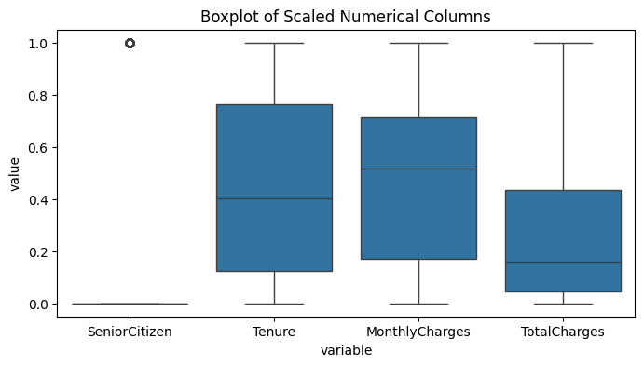
Box Plot
Tenure and MonthlyCharges show wider spread and higher medians, indicating more variability and generally higher normalized values compared to SeniorCitizen and TotalCharges.
SeniorCitizen is mostly near zero with a few outliers, while TotalCharges has a lower median and moderate spread, suggesting most customers have relatively lower scaled total charges.

Slide 5
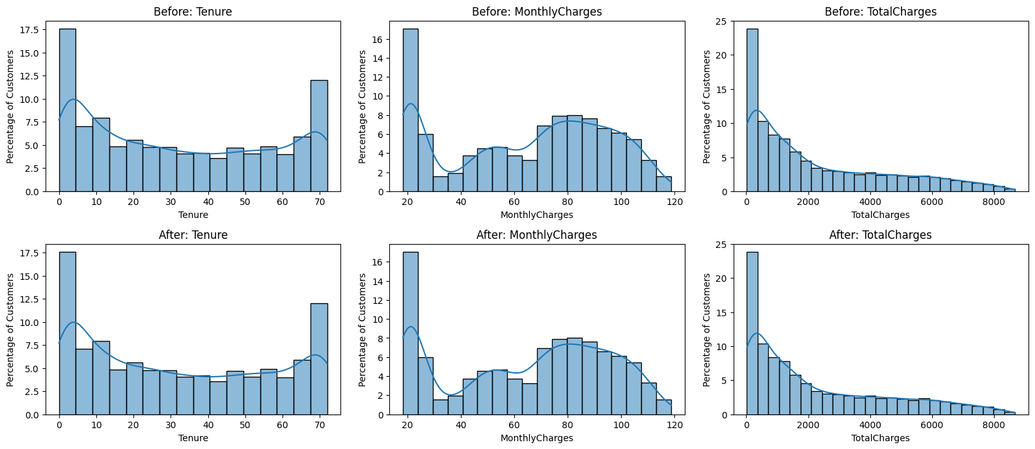
Histogram Distribution
This graph shows the data before and after applying outlier removal using the Z-score method.

Slide 6
From Above image we observe that:
1. Tenure Distribution
Findings: Most customers fall between 0–12 months; cleaning didn’t change the shape.
Insights: Customer base is dominated by new users.
Recommendation: Strengthen early onboarding and first-90-days engagement.
2. MonthlyCharges Distribution
Findings: Two charge groups appear (low 15–40, high 70–110); no major outliers.
Insights: High-charge customers form the largest segment and are more churn-prone.
Recommendation: Offer flexible or discounted plan options for high-paying users.
3. TotalCharges Distribution
Findings: Strong right skew; low values for new customers, high values for long-term users.
Insights: TotalCharges reflects customer age — low values = new customers.
Recommendation: Target low-TotalCharge users with retention programs and long-term offers.

Slide 7
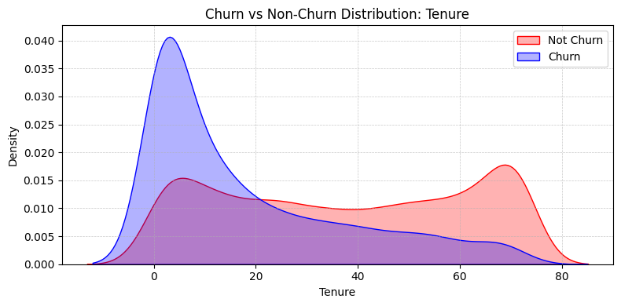
Kernal Density Estimate Plot : Tenure
1. Tenure vs Churn
Findings: Customers with very low tenure (0–12 months) show a much higher churn density.
Insights: Churners are mainly new customers who leave early in their lifecycle.
Recommendation: Implement a strong onboarding + first-90-days retention strategy.

Slide 8
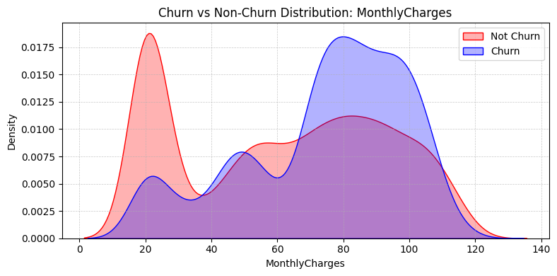
Kernal Density Estimate Plot : MonthlyCharges
2. MonthlyCharges vs Churn
Findings: Churn probability is higher for customers paying higher monthly charges($) (≈ $70–100).
Insights: High-priced plans are perceived as expensive or poor value, pushing customers out.
Recommendation: Introduce flexible/cheaper versions of high-priced plans.

Slide 9
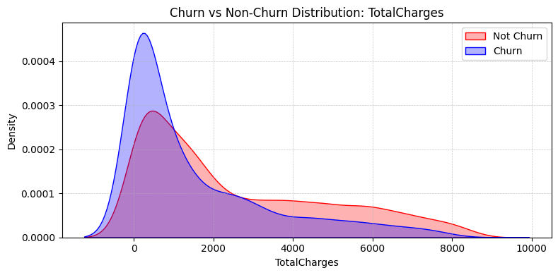
Kernal Density Estimate Plot : TotalCharges
3. TotalCharges vs Churn
Findings: Customers with high total charges (loyal customers) show very low churn.
Insights: TotalCharges acts as a proxy for tenure — low total spend = new customers. Customers with higher lifetime value (LTV) tend to stay longer.
Recommendation: Identify low-TotalCharge customers as early churn risk. Encourage long-term commitment using:1-year or 2-year contract discounts

Slide 10
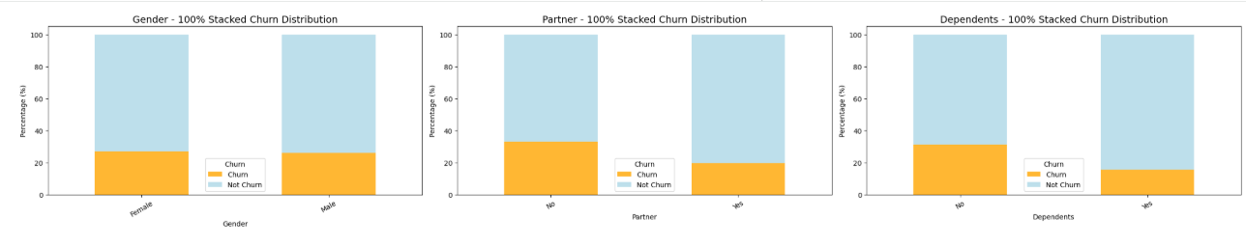
100% Stacked Churn Distribution
1. Gender vs Churn
Findings: Churn rate is slightly higher for females compared to males.
Insights: Gender has only a mild effect on churn — not a strong predictor.
Recommendation: No gender-based customer strategy required; focus on stronger churn drivers.
2. Partner vs Churn
Findings: Customers without partners churn at a much higher rate.
Insights: Single or living-alone customers may have lower stickiness or income stability.
Recommendation: Create loyalty perks / bundles to improve retention among non-partner customers.
3. Dependents vs Churn
Findings: Customers without dependents churn more often.
Insights: Families (with dependents) are more stable and value consistent service and retain this group.
Recommendation: Offer family bundles or multi-device discounts to attract and retain this group.

Slide 11
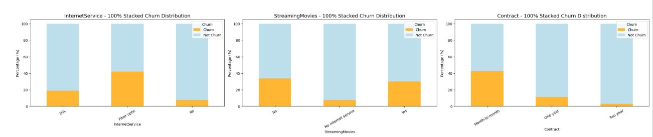
4. InternetService vs Churn
Findings: Fiber optic users have the highest churn. DSL has moderate churn; No-internet-service customers have very low churn.
Insights: Fiber optic plans are expensive — pushing price-sensitive customers to churn.
Recommendation: Reduce price friction for fiber plans through discounts or flexible billing.
5. StreamingMovies vs Churn
Findings: Customers using streaming services (Movies/TV) churn slightly more than those who do not.
Insights: Heavy service users may be more aware of performance issues (speed/quality).
Recommendation: Ensure strong performance and promote streaming-optimized internet packages.
6. Contract Type vs Churn
Findings: Highest churn: Month-to-month, Lowest churn: Two-year contract
Insights: Short-term contracts give customers easy exit options → more churn.
Recommendation: Push customers toward annual or two-year contracts using discounts or perks.

Slide 12
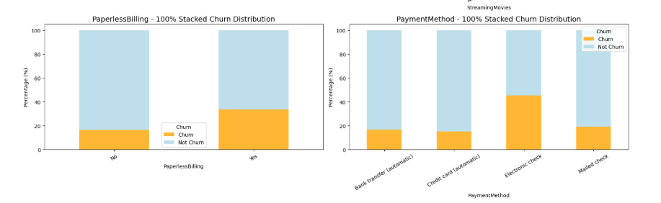
7. PaperlessBilling vs Churn
Findings: Paperless billing customers churn more.
Insights: Paperless billing often correlates with month-to-month contracts and digital-only customers
Recommendation: Provide incentives for paperless customers to move to long-term contracts.
8. PaymentMethod vs Churn
Findings: Highest churn: Electronic check users, Lowest churn: Automatic bank transfer / Credit card automatic
Insights: Electronic check users may face payment friction causing churn. Autopay customers are more stable and low-risk.
Recommendation: Promote auto-debit payment options with incentives (cashback/small discounts).

Slide 13
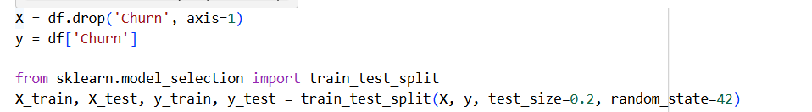
Modelling
The dataset was divided into Training and Testing sets using an 80:20 ratio. This means 80% of the data was used to train the model, and the remaining 20% was used to evaluate its performance.
The target variable for prediction is Churn.
Churn indicates whether a customer leaves the service (Yes) or stays (No). All other columns in the dataset act as independent (input) features.
All other columns in the dataset act as independent (input) features.
These include demographic details, service-related fields, and account information that help the model learn patterns related to churn.
The purpose of the split is to ensure the model learns from one portion of the data (training set) and is evaluated on completely unseen data (testing set) — this avoids overfitting and ensures reliable performance measurement.

Slide 14
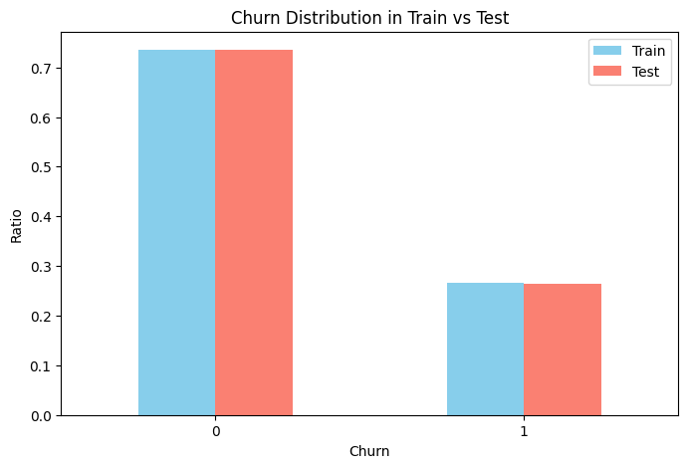
Train–Test Churn Distribution
The train and test sets have nearly identical churn ratios, ensuring a balanced and unbiased model evaluation.
Non-churn customers (Class 0) make up around 73–74% in both sets.
Churn customers (Class 1) make up around 26–27% in both sets.

Slide 15
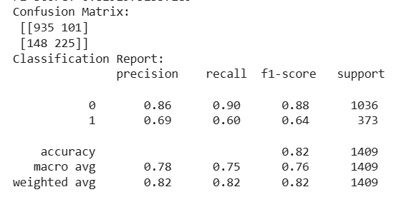
Model Evaluation (Classification)
Accuracy: Measures how many predictions are correct out of all predictions.
Accuracy = (TP + TN) / (TP + TN + FP + FN)
Precision: Of the customers predicted as churn, how many actually churned? Useful when false positives matter. (Precision = TP / (TP + FP))
Recall (Sensitivity): How many of the actual positive cases your model successfully caught. Of all actual churners, how many the model correctly identified.
Recall = TP / (TP + FN)
F1 Score: Balance between Precision and Recall(Harmonic mean of Precision and Recall); best for imbalanced datasets.
Confusion Matrix: Shows TP, TN, FP, FN to understand model’s types of errors.
ROC–AUC Score: Shows how well the model separates churn vs. non-churn cases. AUC closer to 1.0 = excellent classifier.
Classification Report: Detailed summary of Precision, Recall, and F1 for each class.

Slide 16
Model Summary and Selection Justification
We evaluated multiple classification models to identify the most suitable algorithm for our dataset. The performance was compared using accuracy, and the results are as follows:
Since Logistic Regression, SVM, and XGBoost achieved the highest accuracy (0.82), these models are the most suitable for deployment.
Among them, the final model can be selected based on additional metrics like interpretability, computation time, and consistency across validation methods.

